Slide 1
NIRAMAYA
FREE DRUGS & MEDICAL CONSUMABLES
SCHEME OF GOVT OF ODISHA
Collectors’ Conference
28.10.2017

Slide 2
OBJECTIVE OF NIRAMAYA
Reduce substantial out of pocket expenditure of citizens on medical treatment by providing drugs free of cost under the Essential Drug List and other specialised drugs & essential medical consumables in Govt. health facilities up to PHC level.
UNDERSTANDING ESSENTIAL DRUGS LIST (EDL)
As per WHO guidelines, those drugs which satisfy needs of majority of population in treating majority of illness/diseases commonly encountered in health facilities.
Presently 573 number of drugs have been included by the State under EDL.
What the EDL does not contain?
Many commonly prescribed combination drugs, cough syrups, vitamin supplements etc. which are not considered essential.

Slide 3
How availability of Essential and other Drugs is ensured?
(a) PROCUREMENT
Total budget for 2017-18:- Rs. 250 Crores.
Central Procurement through OSMCL (80% of total drugs procurement budget allotted). Items to be procured by OSMCL (~ 593)
SL No. | Description | No. of Items
1 | EDL drugs | 317
2 | Medical Consumables | 83
3 | Anti-cancer items | 107
4 | OSACS | 21
5 | Child Health | 6
6 | Nutrition programme | 6
7 | Malaria control programme | 28
8 | Leprosy | 5
9 | Non-EDL | 20

Slide 4
Local Procurement by Districts/Health Facilities (20% of Total Budget)
What can be procured locally & under which circumstances?
EDL drugs not procured centrally, but being prescribed.
Drugs under central procurement by OSMCL, but under temporary stock-out.
Any other life saving drugs required under emergency, but on written certification of the treating doctor.

Slide 5
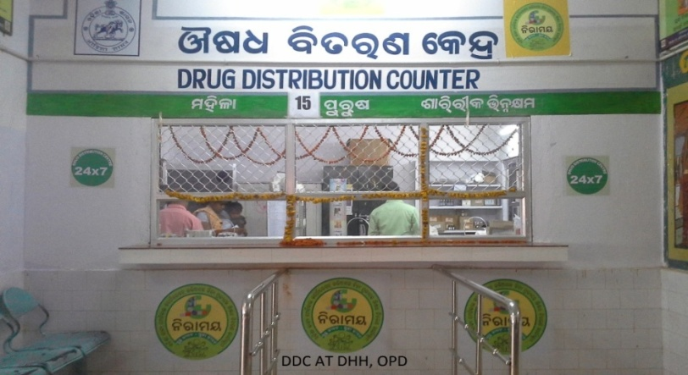
(b) DISTRIBUTION
Central Procurement drugs received from suppliers at 39 Drug Warehouses located in Districts and Health Institutions and released after Quality Testing.
Local procurement drugs distributed by District Head Quarter Hospitals to facilities down below.
Dedicated fleet of 49 vehicles of OSMCL presently utilised for distribution up to PHC level.
Indents as per requirement being given by Health Facilities through e-Niramaya software.
Block Drug Warehouses infrastructure is being strengthened and utilised.
495 Drug Distribution Centers (DDCs) equipped with IT enabled system and dedicated manpower up to CHC level.

Slide 8
(c) PRESCRIPTION
Except in case of justified need, to be certified in writing, only generic medicines available under “Niramaya” shall be prescribed. All prescriptions to be in generic name of drugs in Capital letters and bear full signature of doctor with their seal bearing name.
Prescription shall be only in the prescribed form.
Prescription audit shall be done regularly by Therapeutic Committees at Facility, District & Block level after scanning of all prescriptions.

Slide 9
(d) Role & Responsibility
OSMCL: Timely procurement and delivery of items listed for Central Procurement.
State Drug Management Unit under DHS: Overall scheme monitoring
District Level: CDMOs, ADMOs(Med), SDMOs, M.Os(I/c) of CHCs under overall monitoring at the district level on all aspects of the scheme by the Collectors/CDMOs/Heads of Facilities.

Slide 10
(e) MONITORING AT DISTRICT LEVEL
Stock monitoring through e-Niramaya software. Regular entry of local procurements & transactions in software to be ensured.
Prompt action on findings of State Level Squads.
Regular & surprise visits by District Level Squads
Collectors to monitor Local procurement, Branding, Visibility & prompt Grievance Redressal system
Utilisation of 2o% budget allotted to CDMOs/Other Health Facilities (District wise details)
DDC Counter (Niramaya Counter) at a conspicuous & easily accessible place in the facility.
Signages in the health facility with directions leading to Niramaya Counter.
Branded Information board at the Niramaya Counter with scope of Niramaya & opening & closing hours.
Display board to mention contact details of the Officer handling Niramaya in the facility.
WhatsApp group for immediate redressal of gaps

Slide 11
Let us ensure no patient goes without medicines provided free of cost in Government Health Facilities under NIRAMAYA THANK YOU….

